Slide 1
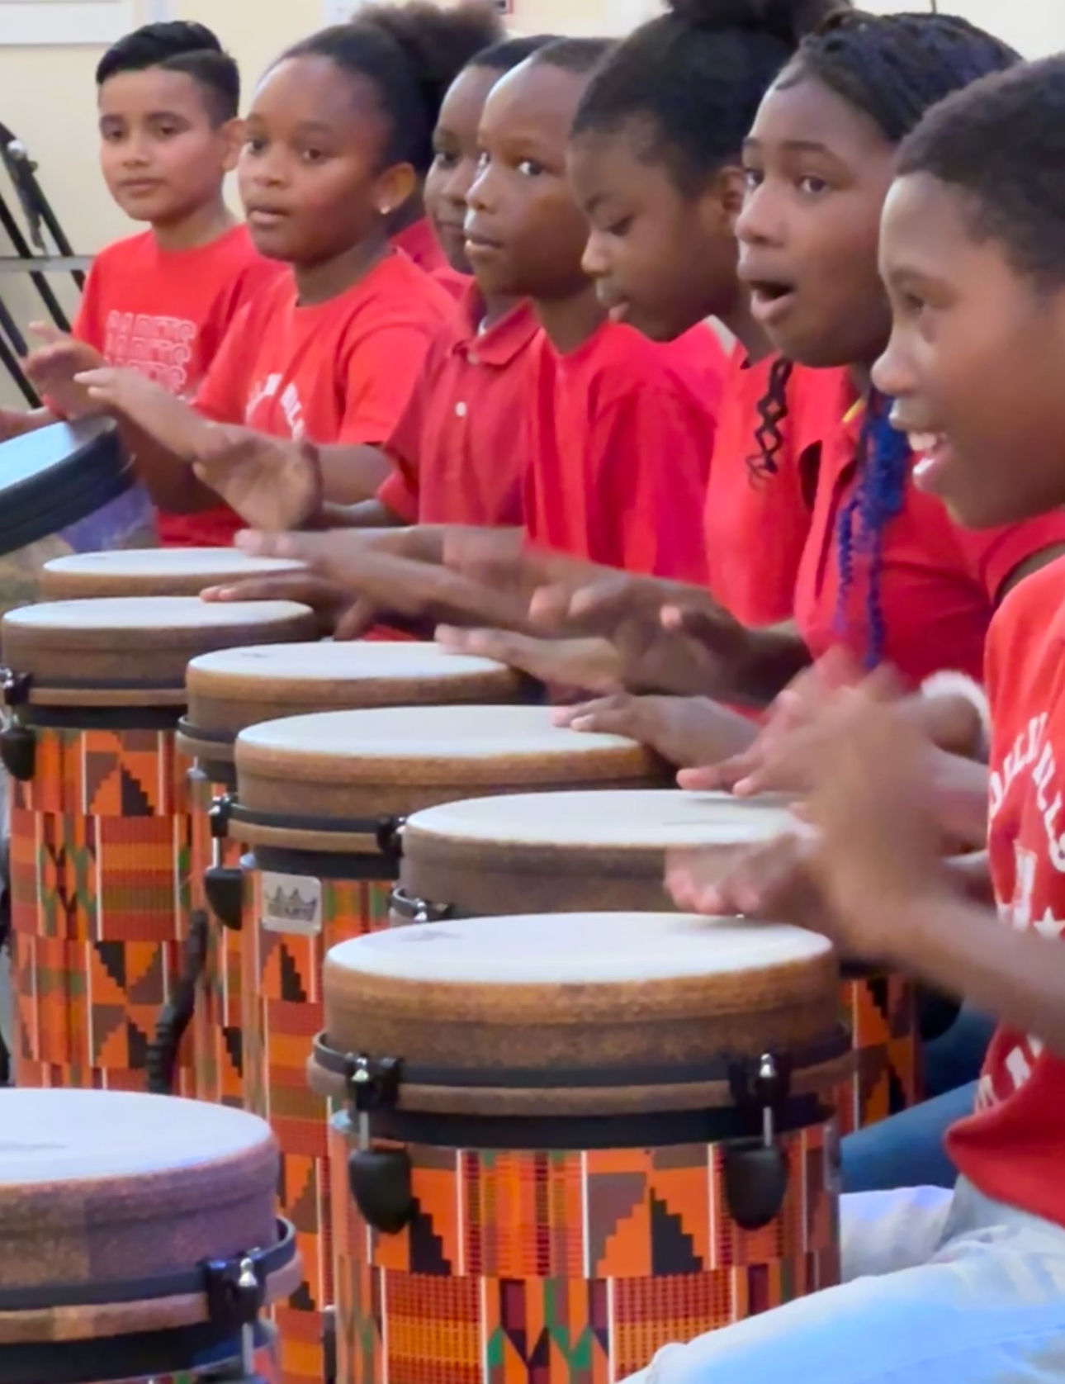
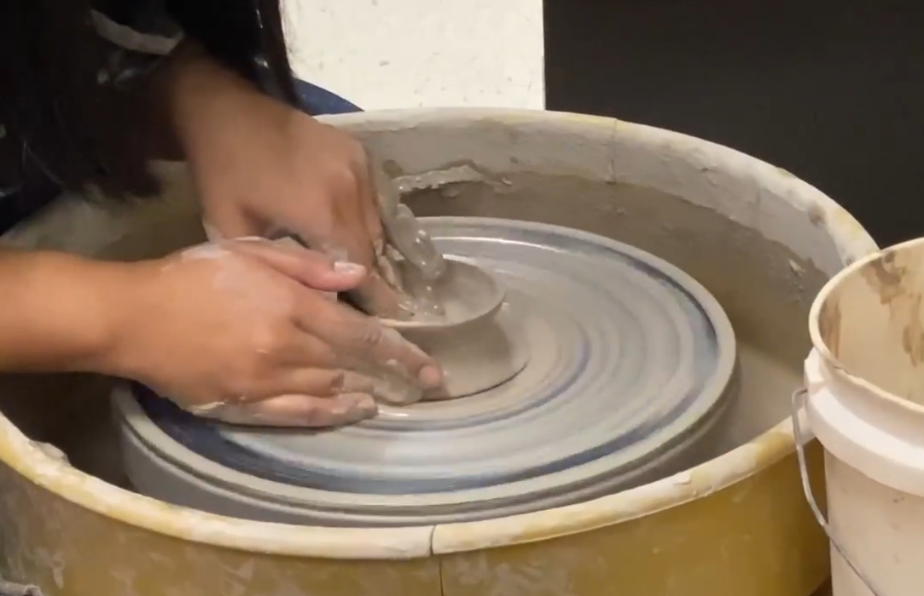
Visual & Performing Arts
January 19, 2024

Slide 2
Statement of Principle

Slide 3
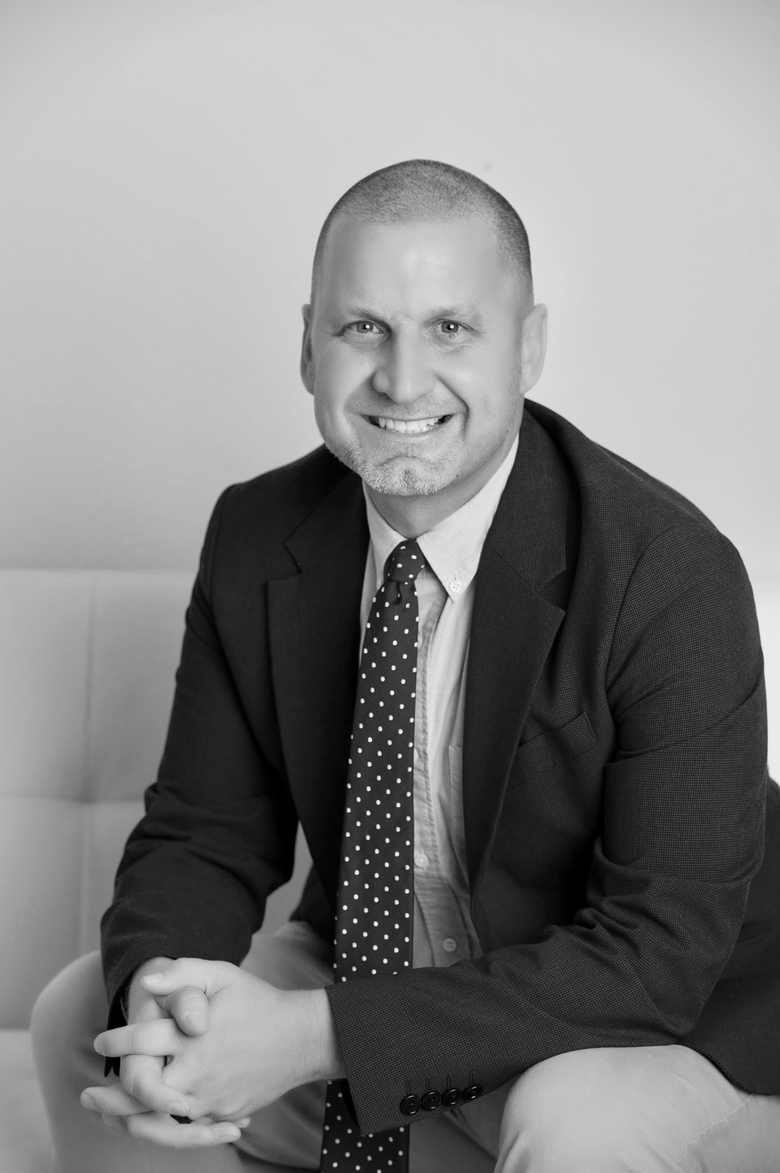
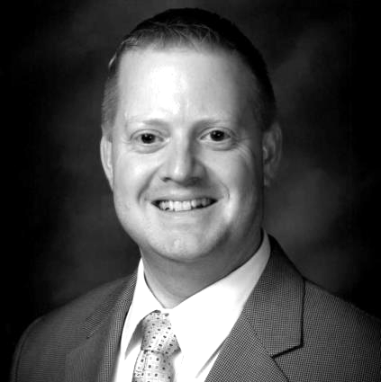
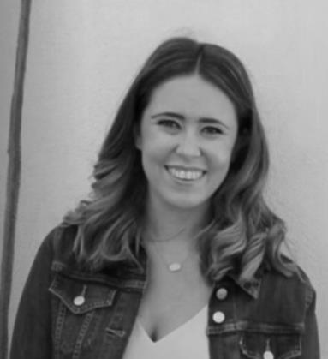
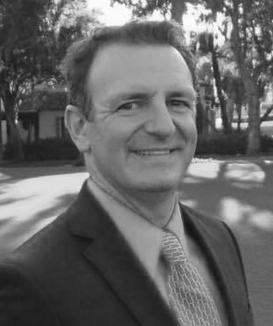
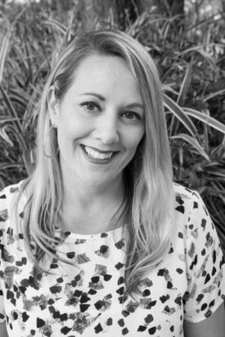
VPA District Team
Jason Locker
Senior Administrator
Scott Evans
Senior Director
Emily Kinnunen
Program Specialist
Elementary Music
Chris Cause
Program Specialist
Dance & Theatre
Bryan Munera
Program Specialist
Secondary Music
Christy Garton
Program Specialist
Visual Art K12
THE TEAM

Slide 4
Visual & Performing Arts
Dance
Theatre
Music
Visual Arts

Slide 5
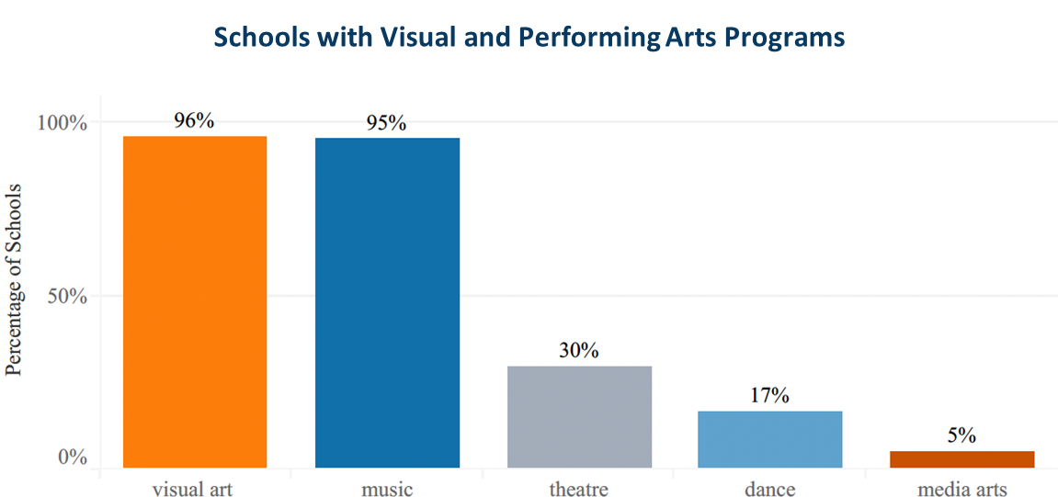
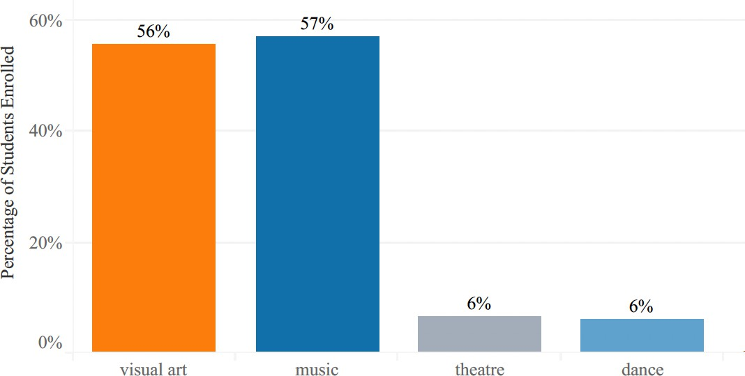
Access
100%
Schools with Visual and Performing Arts
Students Enrolled in Visual and Performing Arts

Slide 6
Visual Arts
Drawing
Digital Arts
Ceramics
Painting
Exhibitions

Slide 7
Performing Arts
Theatre Tech
Band
AP Theory
Acting
Guitar
Chorus
Orchestra
General Music
Dance
Keyboard

Slide 8
Partnerships

Slide 9
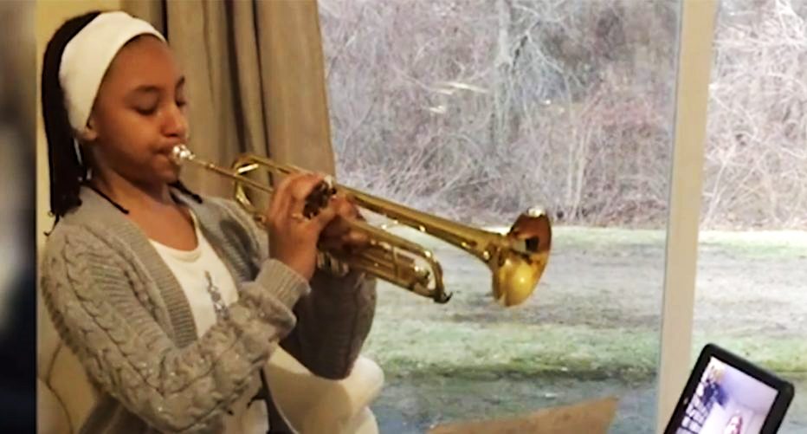
Private Tutoring 1:1

Slide 10
Results

Slide 11
The artist is not a special kind of person; rather each person is a special kind of artist.
Ananda Kentish Muthu Coomaraswamy

